Slide 1
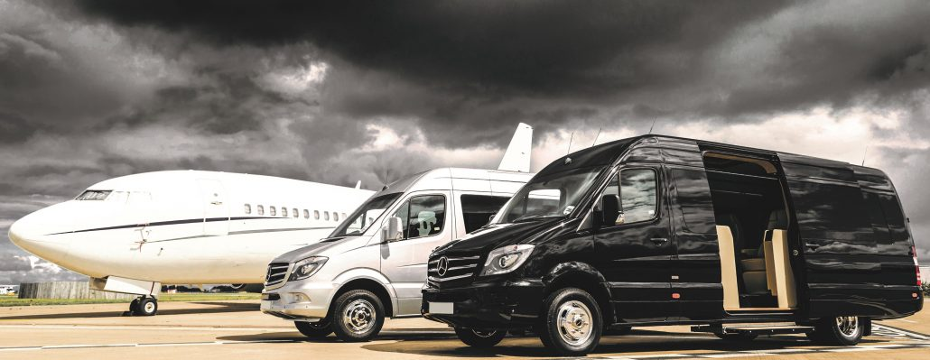
SMARTCOMMUTE
OPTIMIZING EMPLOYEE TRANSPORTATION WITH ADVANCED ROUTING STRATEGIES

Slide 2
Agenda
Introduction
Problem Description
Methodology
Results & Outcomes
Web Application & Conclusion
Presentation Title

Slide 3

INTRODUCTION & PROBLEM STATEMENT

Slide 4
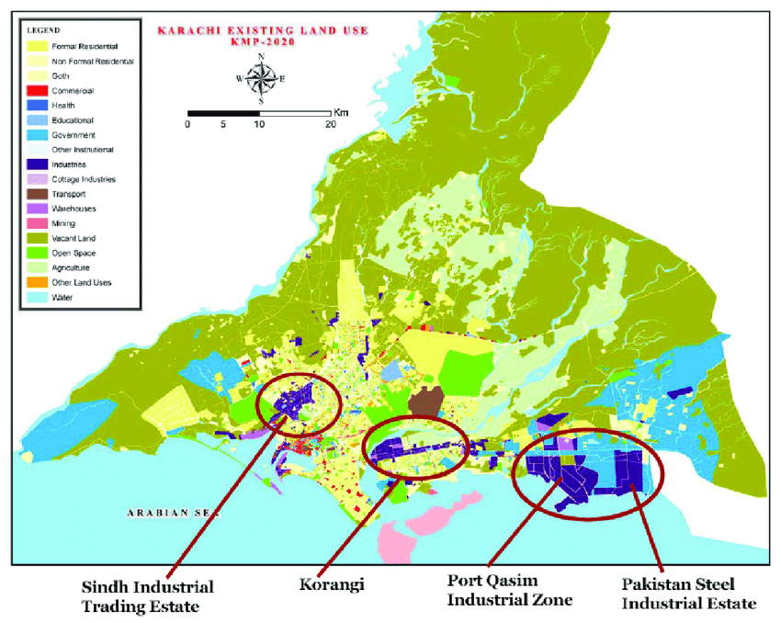
Introduction
Karachi is a magacity with highest population in Pakistan. Being the port city, Karachi has the significant contribution in country’s economy due to largest industrial sector among all major cities in Pakistan.
Transportation in Karachi is a significant challenge due to exhausting road infrastructure and ever-increasing traffic congestions.
The most effected public segment is of daily commuters who travel to work specially in rush hours. It is estimated that it usually takes upto 3 hours to commute from one industrial zone to another end of the main city.
Similarly, employers also find it difficult to maintain punctuality and cost efficiency while providing convenience to their workforce in terms of daily transportation.
Notes:
TY - THES
AU - Owais, Azeemah
PY - 2020/09/01
SP -
T1 - Economic Reform and Urban Development The Case of Informal Textile Industry of Karachi A Thesis submitted in the Partial Fulfilment for the Requirement of the Degree of Master of Science in Integrated Urbanism and Sustainable Design
VL -
ER -

Slide 5
PROBLEM
Far From City
Located approx. 40Kms away from city center
Manual routes planning
Estimated 30% of the employees need to be reallocated a vehicle after 1st run
Costs
Increasing Fuel costs are challenging the sector to revise their cost structures
Employee Well-being
Loss of productivity due to hectic travel routines

Slide 6
Problem Statement
Industries located outside main cities provide transportation to their employees. It also involves transport rescheduling and re-routing due to dynamic operating conditions, change in schedules, multiple shifts, employee turnover and other factors. It results in several inefficiencies related to costs, staff punctuality, employee satisfaction and lack of agile planning.
By taking example of one corporate firm in Karachi (i.e. Lucky Motor Corporation) for reference location. This project aims to build and deliver a comprehensive system which builds and improves daily commutes through efficient and dynamic transportation routes planning by harnessing the data and power of latest algorithms & technologies.
Notes:
TY - THES
AU - Owais, Azeemah
PY - 2020/09/01
SP -
T1 - Economic Reform and Urban Development The Case of Informal Textile Industry of Karachi A Thesis submitted in the Partial Fulfilment for the Requirement of the Degree of Master of Science in Integrated Urbanism and Sustainable Design
VL -
ER -

Slide 7
THE SOLUTION: Key Features Definitions & Inputs Methodology Algorithms Evaluation Matrices

Slide 8
KEY FEATURES
BRIDGING THE GAP
MULTIPLE ROUTING OPTIONS
Bridging the gap between employee & transport coordinator
In case of new joinings, shift changes & other variations system will be agile enough to respond quickly
Administrator can choose from a set of different combinations of routing algorithms
Results comparison aids informed decision and route finalization
OPTIMIZED ROUTES
COST SAVINGS
Use of Technology to generate Cost & Time efficient routes instantly
Google Maps API Data and advanced routing techniques improve routing efficiency
Data Availability enables precise cost structure implementations
travel times - distances – vehicle occupancy

Slide 9
DEFINITIONS:
Shifts (Timings):
Employee Center Shift is represented by EC with working hours from 08:00 AM till 05:00 PM
General Shift for other Management Staff is represented by GS with working hours from 07:00 AM till 05:00 PM
Employee Strength:
Employee Center Shift (EC): 80 Employees
General Shift (GS): 113 Employees
Vehicle Capacity:
Maximum Vehicle Capacity is 9 except few exceptions. Hence, all runs are based on capacity of 8 or 9 employees per vehicle.
Number of Vehicle:
Number of vehicle are calculated based on number of employees in particular shift and vehicle capacity with an additional buffer of ~10%.

Slide 10
INPUT FILES:
lat_lon_ec.csv/
Lat_lon_gen:
This file contains the coordinates of all employees with the coordinates of factory at index 0.
Distance Matrix:
This .csv file contains the distance matrix and time matrix ordered as per coordinates file. Google maps API is used to populate it as per the time of day for pickup and dropoff of each shift to make system more robust to specific traffic conditions . It is named as per below convention for different Shifts.
DM_dropoff1700departure.CSV
DM or TM for Distance Matrix or Time Matrix.
dropoff or pickup for transit type.
1700departure or 0800arrival for respective shift time.

Slide 11
METHODOLOGY
Data Preparation:
Mapping of coordinates for each employee.
Definition of Shift Timings.
Generation of Distance & Time Matrix based upon Pickup & Dropoff Times.*
Defining the vehicle capacity & number of available vehicles for routing.
API Key for Google Maps.
Algorithms:
The problem is divided into two Sub-Problems.
Clustering/Clubbing of employees and assigning to vehicles. It involved the use of below algorithms: a) Clarke Wright Savings (CWS) Latest Routing Solution b) Genetic Algorithm (GA) Traditional Heuristics Based Approach c) K-means Clustering (Kmeans) ML based approach d) Min_Distance Clustering (min_distance) Self Proposed Approach
Sequencing the employees to find optimum route/path. It included two different methodologies: a) Travelling Salesman Problem (TSP) b) Google Maps API Optimization (GMO)

Slide 12
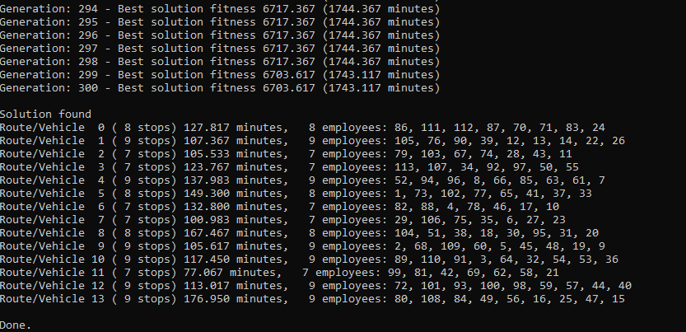
Route Clustering Through Genetic Algorithm by KANG (2015)
Genetic Algorithm that was developed by KANG (2015) has been implemented which was crafted for School Bus Routing, however, it could be applied to subject problem due to same nature of routing.
https://github.com/letrunghieu/school-bus-routing-problem/tree/master?tab=readme-ov-file
Notes:
https://web.mit.edu/urban_or_book/www/book/chapter6/6.4.12.html

Slide 13
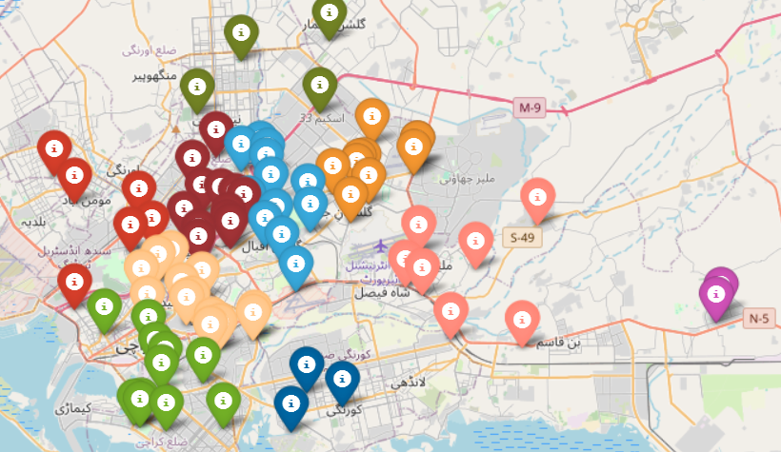
Route Clustering Through ML Algorithms
ML clustering techniques such as Kmeans, Hierarchical & DB Scan Clustering were not found suitable due to following reasons:
Distance Matrix: Use of conventional distance matrics without road network awareness. For Example: Kmeans propagation involves finding cluster centers and then calculating Euclidean distances to cluster further points.
Directional Awareness and Waypoints: These methods does not account for considering particular directions and leads to multiple branches in the final route.
Vehicle Maximum Capacity constraints: However Implementable, appropriate cutoff for capacity constraints is challenging to setup given the varying densities across the city.
Clusters obtained through K-means
Notes:
https

Slide 14
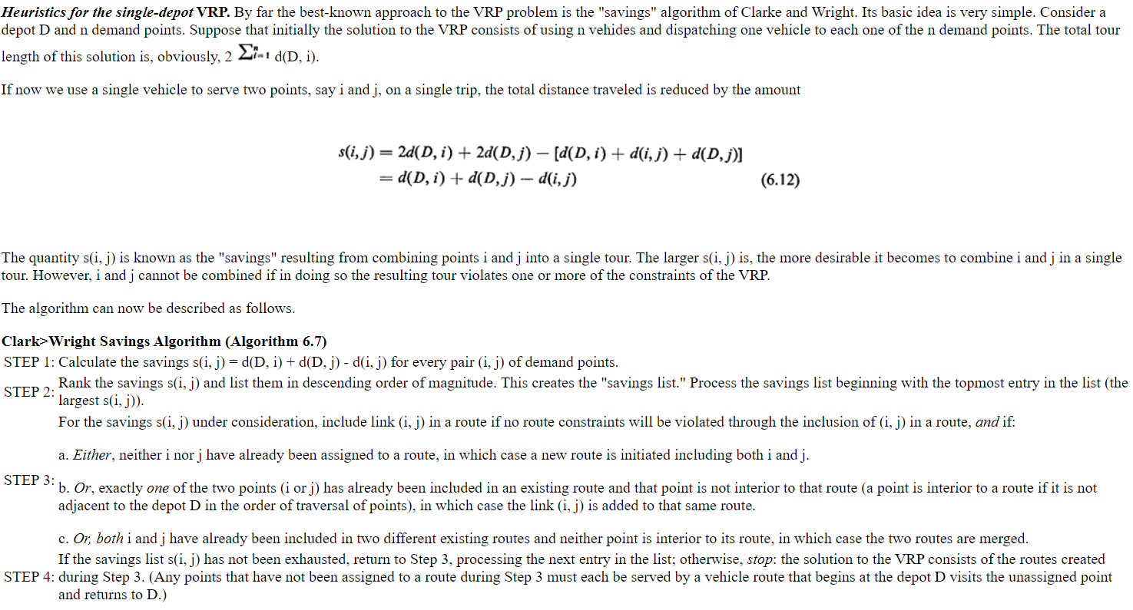
Route Clustering Through Clarke Wright Savings
Notes:
https://web.mit.edu/urban_or_book/www/book/chapter6/6.4.12.html

Slide 15
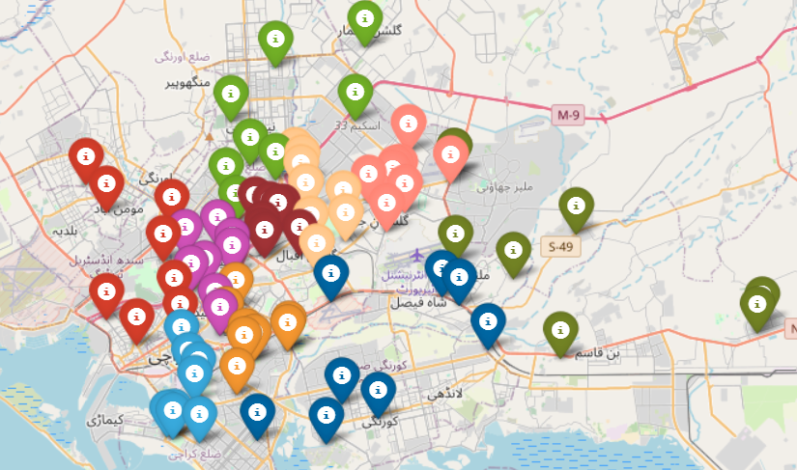
Route Clustering Through Clarke Wright Savings

Slide 16
Route Clustering Through Min_distance Algorithm
Since the Kmeans and similar approaches were not acceptable due to the use of Euclidean or similar 2d distance matrix without road network knowledge. A simpler approach was experimented and named as min_distance due to its preference to minimum distance from the distance matrix.
The steps of its propagation are demonstrated in following slides:

Slide 17
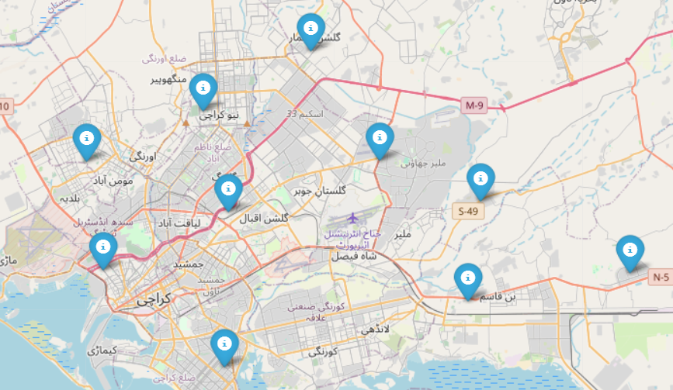
Min-distance: Step # 1
It starts with selecting n number of coordinates which are farthest from themselves and the destination/origin (factory). These n points (coordinates) correspond to the starting point or end point of their routes based on pickup & dropoff condition respectively.

Slide 18
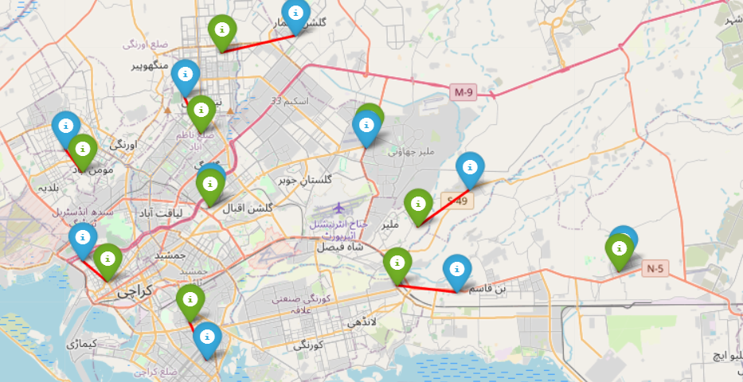
Min-distance: Step # 2
Further, second level of coordinates are selected based on their closest proximity to already selected coordinates.

Slide 19
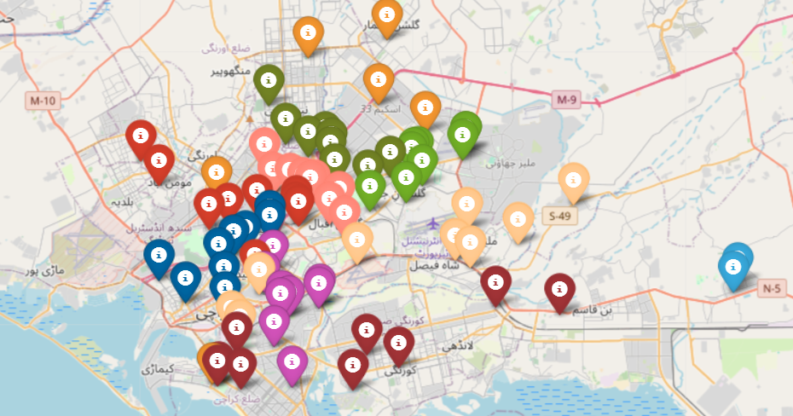
Min-distance: Step # 3
Beyond this step, Distance Matrix is used to find and map the closest unmapped point with closest route until all points are assigned to the closest route while respecting the capacity constraint.

Slide 20
Min-distance: Limitation
As evident from following map, orange-colored coordinates can be seen scattered across the map, it is because the algorithm has much less choice of routes at the end of clustering to assign any given point because all nearby routes reach the maximum capacity. Therefore, the last assignment of coordinates result in scattered last cluster.

Slide 21
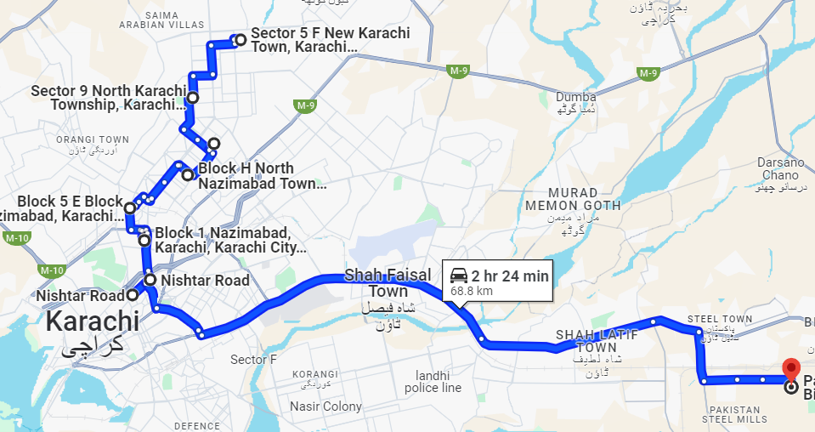
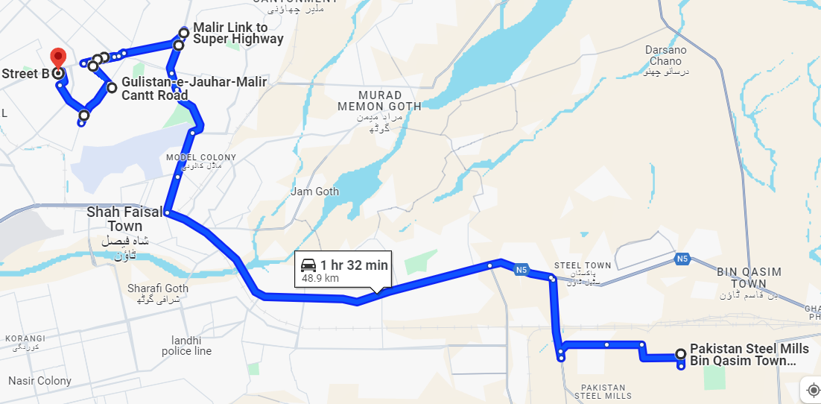
Routing Sequence using TSP
Travelling Salesman Problem (TSP) involves generation of all possible permutations and then finding the lowest distance (cost) cyclic path. It has been implemented with slight modification that I does not create cyclic part, but rather terminates at the end coordinate.
LIMITATION: Due to permutations, the number of calculation increase exponentially. It takes significant amount of time as the size of clusters increase from 9 employees. Therefore, Google Maps optimization is suited for clusters exceeding 9 employees.
EC Pick up Route clustered through Genetic Algorithm and optimized using TSP

Slide 22
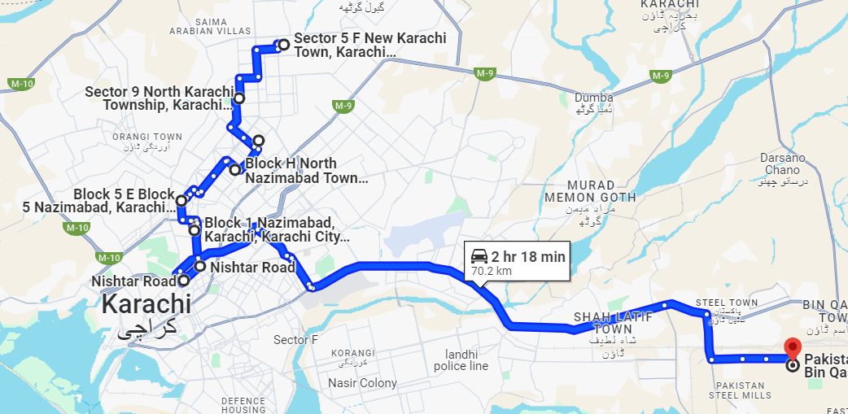
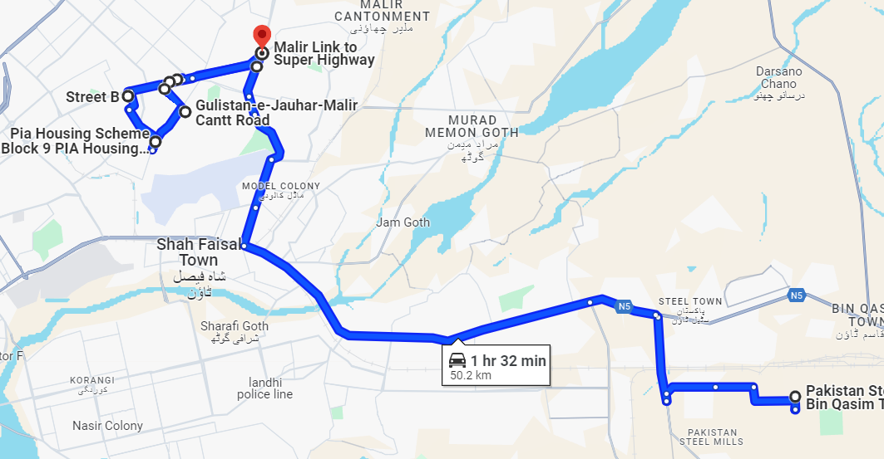
Routing Sequence using GMO
Google Maps API provides built-in feature to optimize the waypoints of routes in terms of time and distance for any given time of the day.
LIMITATION: It requires predefined Origin and Destinations to optimize the sequence of waypoints in between. Hence, the farthest point in the cluster from the factory is marked as origin or destination respectively for pick up and dropoff. Although It resulted in minor inefficiency, the results are competitive to TSP which is time consuming and evaluates all permutations.
EC Pick up Route clustered through Genetic Algorithm and optimized using Google Maps Optimization

Slide 23
Key Matrices for Results Evaluation
1) Total Travelled Distance:
It is the sum of distances covered for each vehicle on each route.
It is an important matric because it is directly proportional to costs, time & employee well-being.
2) Route Wise Avg Distance:
It is the total travelled distance per number of total vehicles.
This matric particularly combines number of routes generated hence it yields lower distance per route if there are more allocated vehicles.
3-4) Max/Min Individual Distance:
It is the maximum/minimum of the distance travelled by all employees in a single pickup or dropoff trip. Minimum travelling distance is crucial for the ergonomics and well-being of an employee.
The results are evaluated on same matrices for duration as well.

Slide 24
Key Matrices for Results Evaluation
6) Combined Individual Durations for Pickup & Dropoff:
Since Smartcommute allows for independent routing combinations for pickup and drop-offs, each Employee may have entirely different routes for the pickup and dropoff.
Therefore, optimum combination of results is also merged to compare with manual routing results for benchmarking

Slide 25

Results Analysis

Slide 26

Analysis: 1. Total Travelled Distance(Kms) & Duration (Mins)
EC Pickup
EC Dropoff

Slide 27
Analysis: 1. Total Travelled Distance(Kms) & Duration (Mins)
GS Pickup
GS Dropoff

Slide 28
Analysis: 2. Route Wise Avg Distance(Kms) & Duration (Mins)
EC Pickup
EC Dropoff

Slide 29
Analysis: 2. Route Wise Avg Distance(Kms) & Duration (Mins)
GS Pickup
GS Dropoff

Slide 30
Analysis: 3. Max Individual Distance(Kms) & Duration (Mins)
EC Pickup
EC Dropoff

Slide 31
Analysis: 3. Max Individual Distance(Kms) & Duration (Mins)
GS Pickup
GS Dropoff

Slide 32
Analysis: 4. Min Individual Distance(Kms) & Duration (Mins)
EC Pickup
EC Dropoff

Slide 33
Analysis: 4. Min Individual Distance(Kms) & Duration (Mins)
GS Pickup
GS Dropoff

Slide 34
RESULTS
 | EC |  | GS
 | Pickup | Dropoff | Pickup | Dropoff
Total Travelled Distance | min_distance | min_distance | CWS | CWS
Total Travelled Duration | min_distance | min_distance | CWS | CWS
Route Wise Average Distance | min_distance | min_distance | CWS | CWS
Route Wise Average Duration | min_distance | min_distance | CWS | CWS
Max Individual Distance | GA | min_distance | CWS | GA
Max Individual Duration | GA | GA | CWS | GA
Min Individual Distance | All | min_distance | GA | GA
Min Individual Duration | All | min_distance | GA | GA
Routing Algorithm | Count
min_distance | 11
CWS | 10
GA | 9
All | 2

Slide 35
KEY FINDINGS
First Level Algorithm i.e. Clustering of Employees
Among of the recent prevailing algorithms, Clarke Wright Savings has been most successful. However, it is not efficient for less dense data.
For the data with lower number of coordinates i.e. EC Shift, the coordinates were more spread out which resulted in CWS to make few random routes due to its limitation of generating exact number of routes as per vehicle capacity and total number of coordinates.
Min_distance performed well for the data with lesser density, it outperformed both GA and CWS. It also provides with the flexibility of defining the number of routes to be generated.
Besides, Min_distance & CWS performing well for reduction of total distances & durations, Genetic Algorithm is noted to have reduced Individual distance & durations, but other algorithms have yielded the same results with negligible increase in time and distance.

Slide 36
KEY FINDINGS
Second Level Algorithm i.e. Routing Sequence
From above results it is evident that TSP is a better approach generate routing sequence.
Furthermore, TSP optimizes routes by evaluating every permutation, it is also very time consuming for routing problems exceeding 9 employees in a single route.

Slide 37
Round Trip Comparison for EC: Min-distance vs Manual Routes
Despite having one less route, min_distance performs better on 6 out of 9 matrices
 |  | min_distance10V9C_TSP |  |  |  | manual_TSP
 |  | Pickup | Dropoff | Total |  | Pickup | Dropoff | Total |  | Difference |  | Favorable Route
Total Travelled Distance (Kms) |  | 567 | 560 | 1,127 |  | 588 | 582 | 1,170 |  | - 43 |  | min_distance10V9C_TSP
Route Wise Average Distance (Kms) |  | 57 | 56 | 113 |  | 53 | 53 | 106 |  | 6 |  | manual_TSP
Max Individual Travelling Distance (Kms) |  | 90 | 69 | 159 |  | 74 | 73 | 147 |  | 12 |  | manual_TSP
Min Individual Travelling Distance(Kms) |  | 11 | 13 | 25 |  | 11 | 14 | 25 |  | - 1 |  | min_distance10V9C_TSP
Total Travelling Duration (Mins) |  | 1,153 | 1,153 | 2,306 |  | 1,186 | 1,166 | 2,352 |  | - 46 |  | min_distance10V9C_TSP
Route Wise Average Duration (Mins) |  | 115 | 115 | 231 |  | 108 | 106 | 214 |  | 17 |  | manual_TSP
Max Individual Travelling Duration (Mins) |  | 172 | 158 | 329 |  | 183 | 182 | 364 |  | - 35 |  | min_distance10V9C_TSP
Min Individual Travelling Duration (Mins) |  | 18 | 20 | 38 |  | 18 | 22 | 39 |  | -2 |  | min_distance10V9C_TSP
No. of Vehicles |  | 10 | 10 | 10 |  | 11 | 11 | 11 |  | -1 |  | min_distance10V9C_TSP

Slide 38
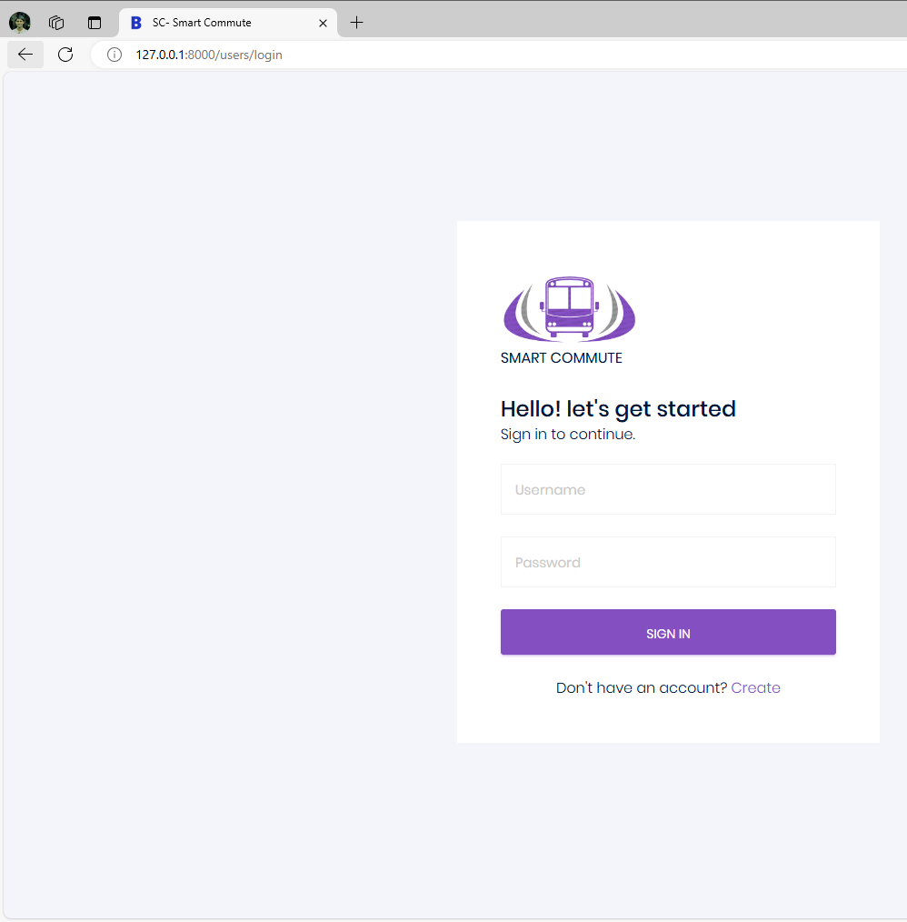
SMARTCOMMUTE WEB APPLICATION

Slide 39
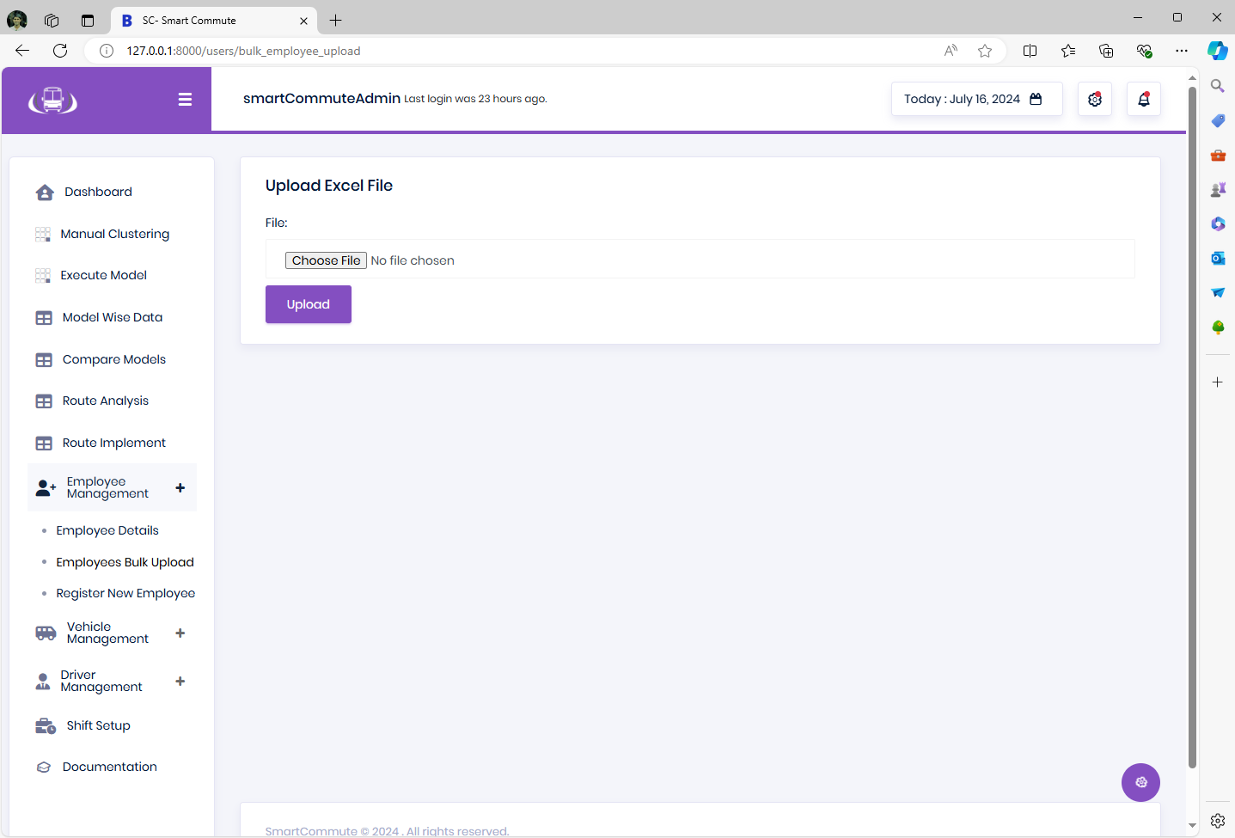
Employee Data Bulk Upload Option

Slide 40
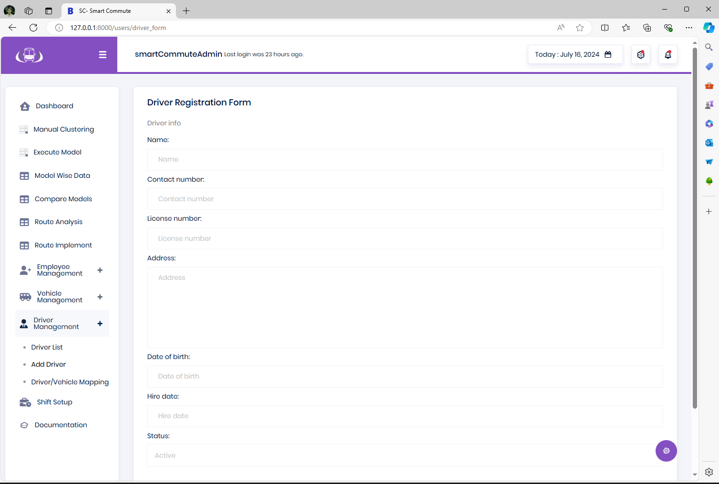
Driver Registration Form

Slide 41
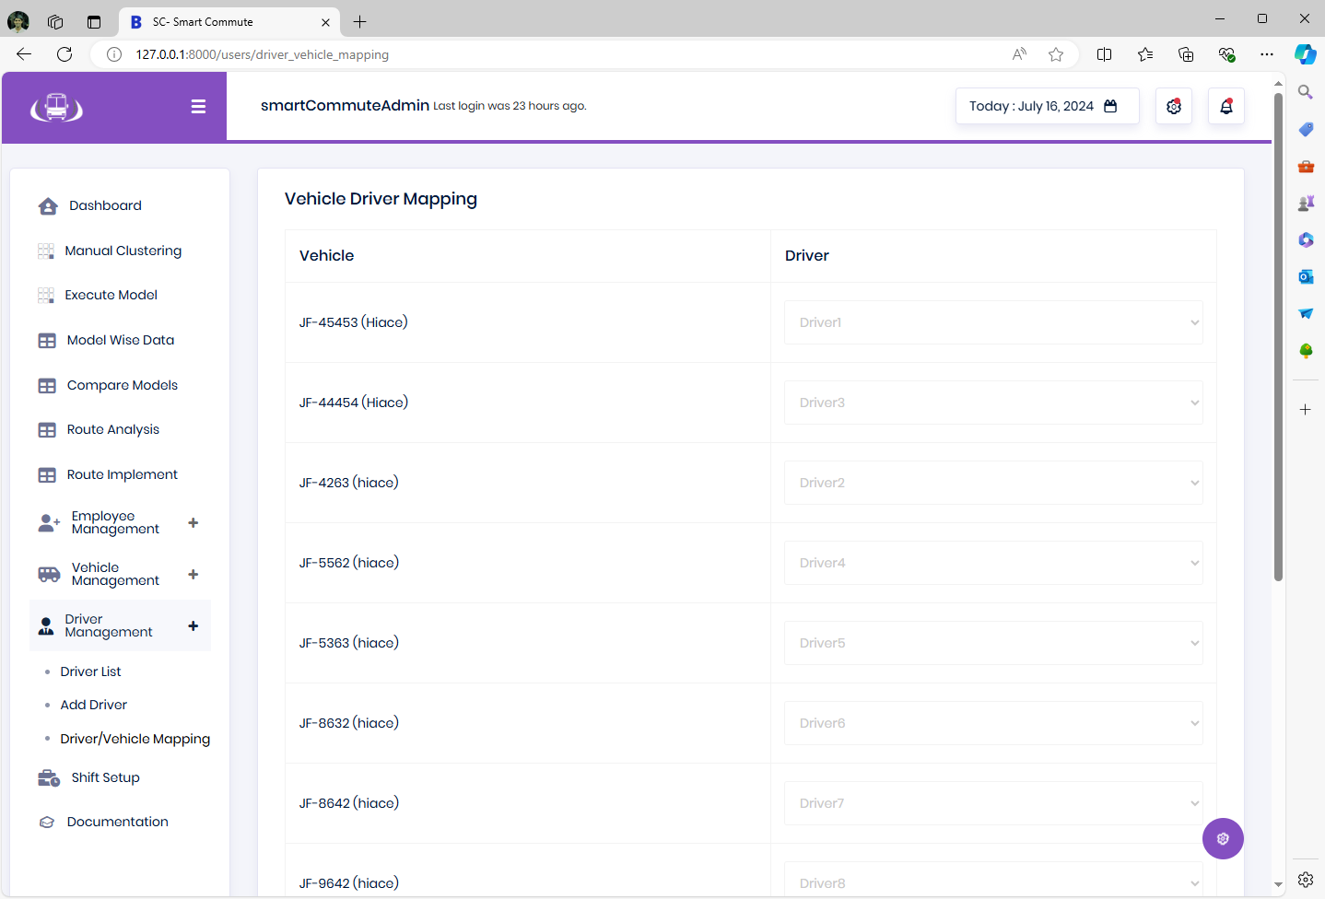
Vehicle – Driver Mapping

Slide 42
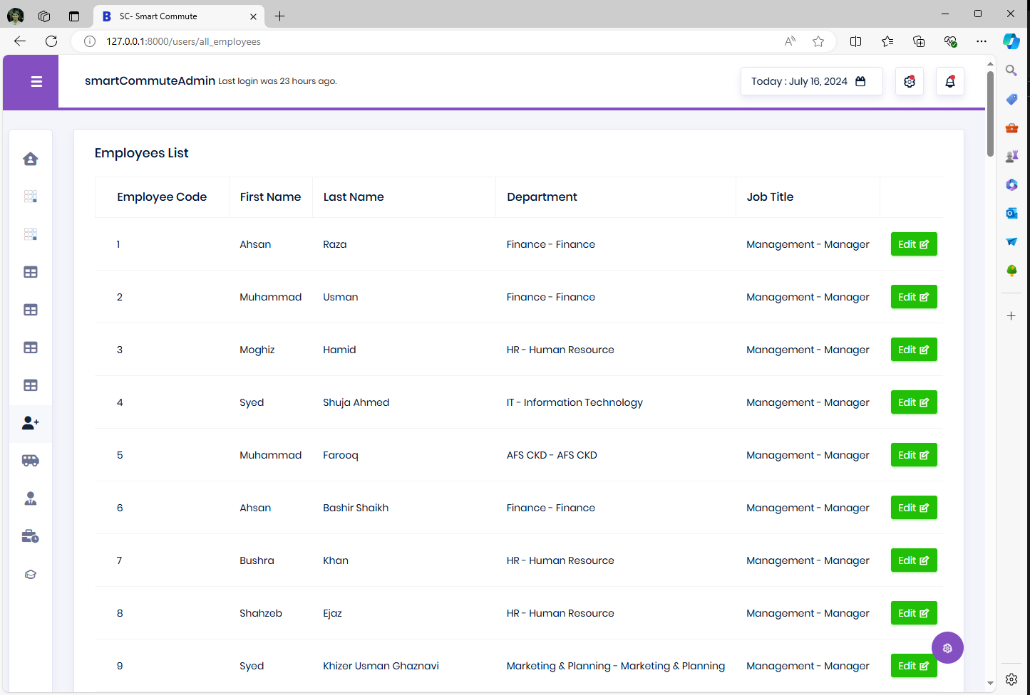
Employee Data Management

Slide 43
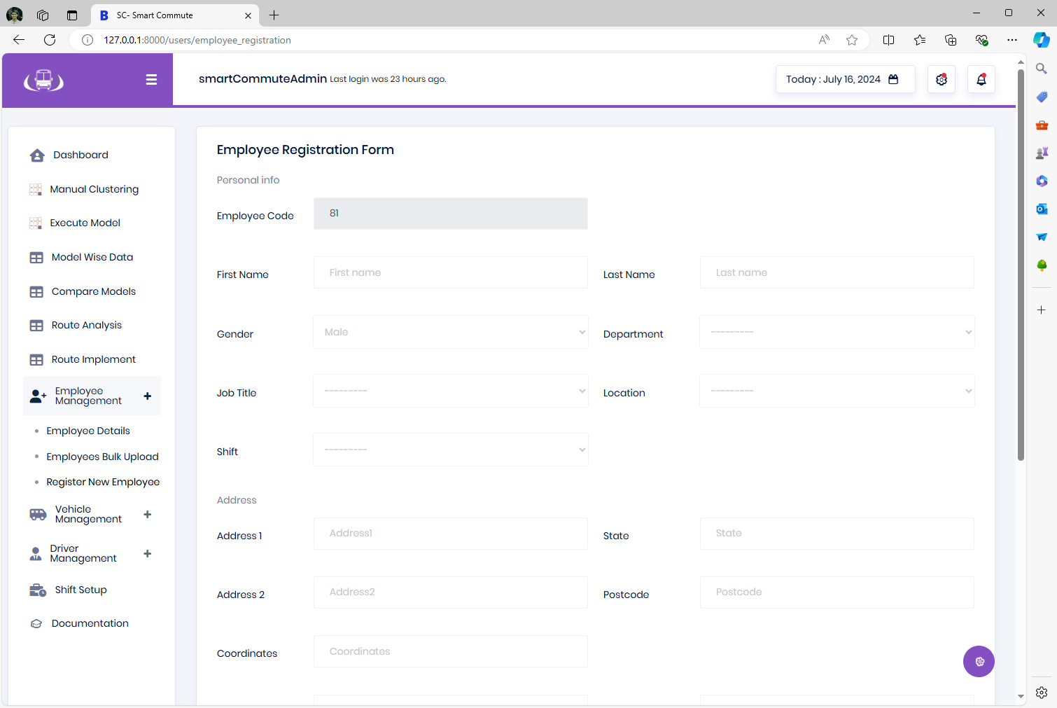
Employee Data Management

Slide 44
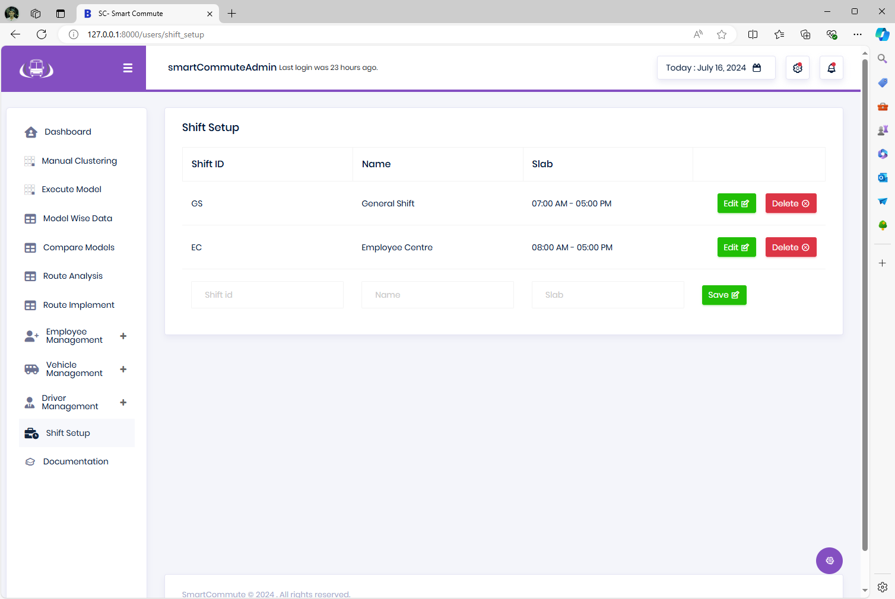
Shift Setup

Slide 45
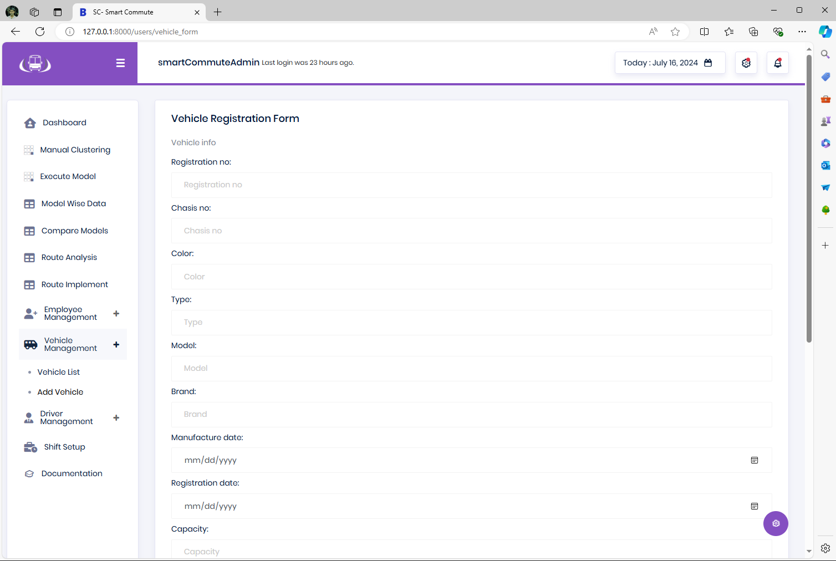
Vehicle Registration Form

Slide 46
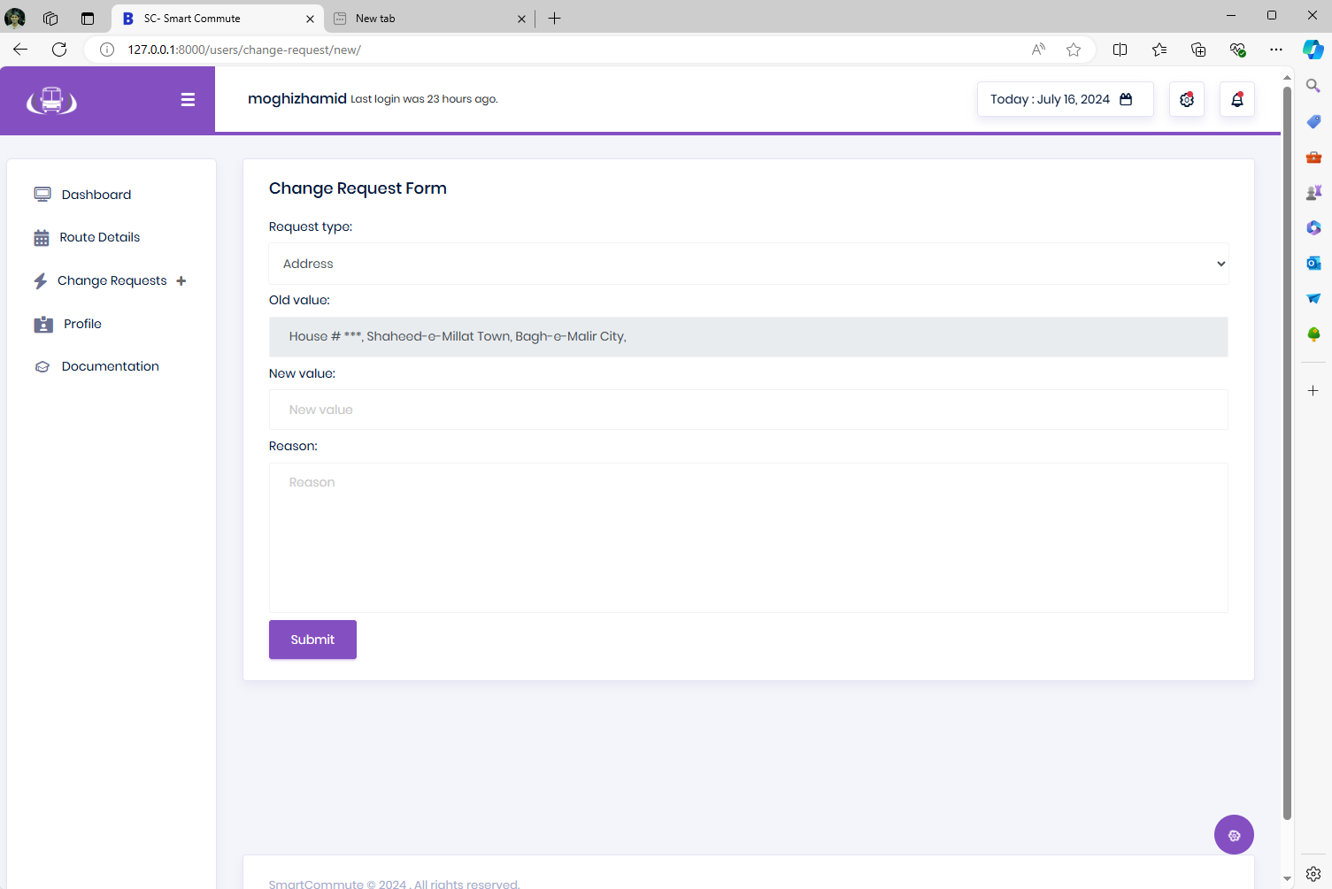
Change Request Form

Slide 47
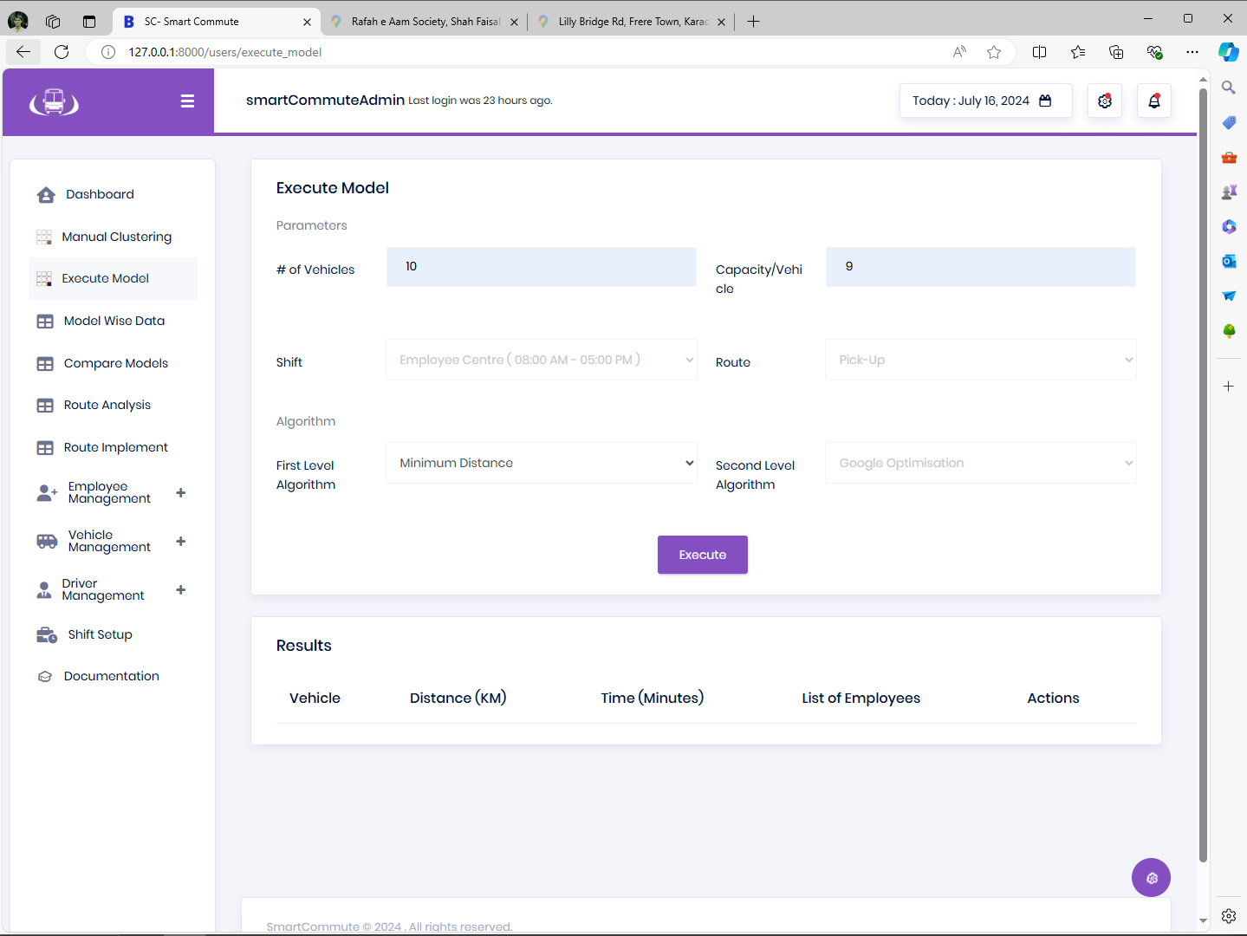
Routing Algorithm Execution

Slide 48
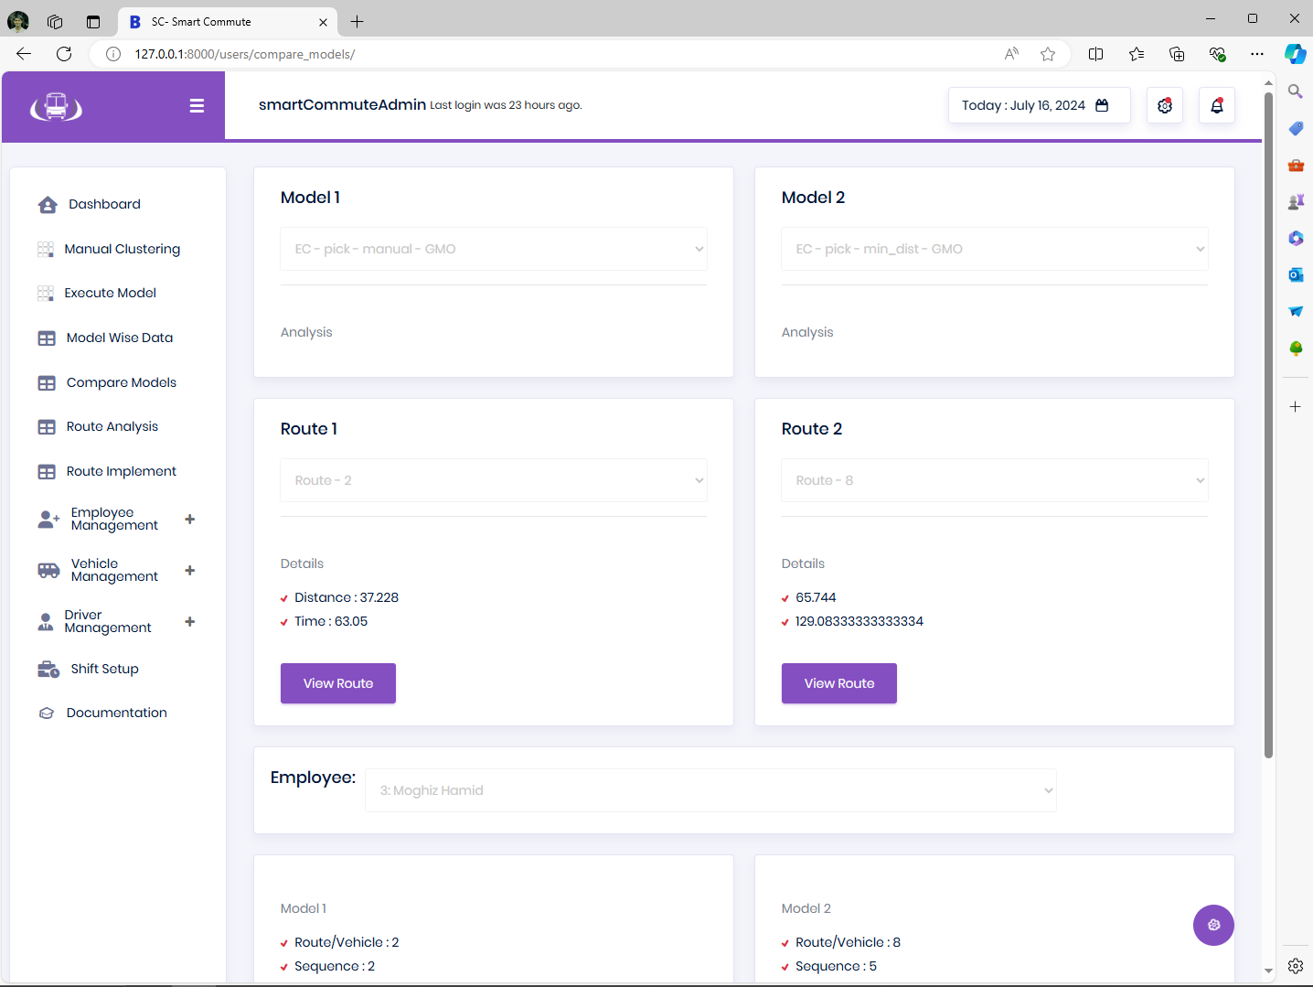
Routing Algorithm Results Comparisons

Slide 49
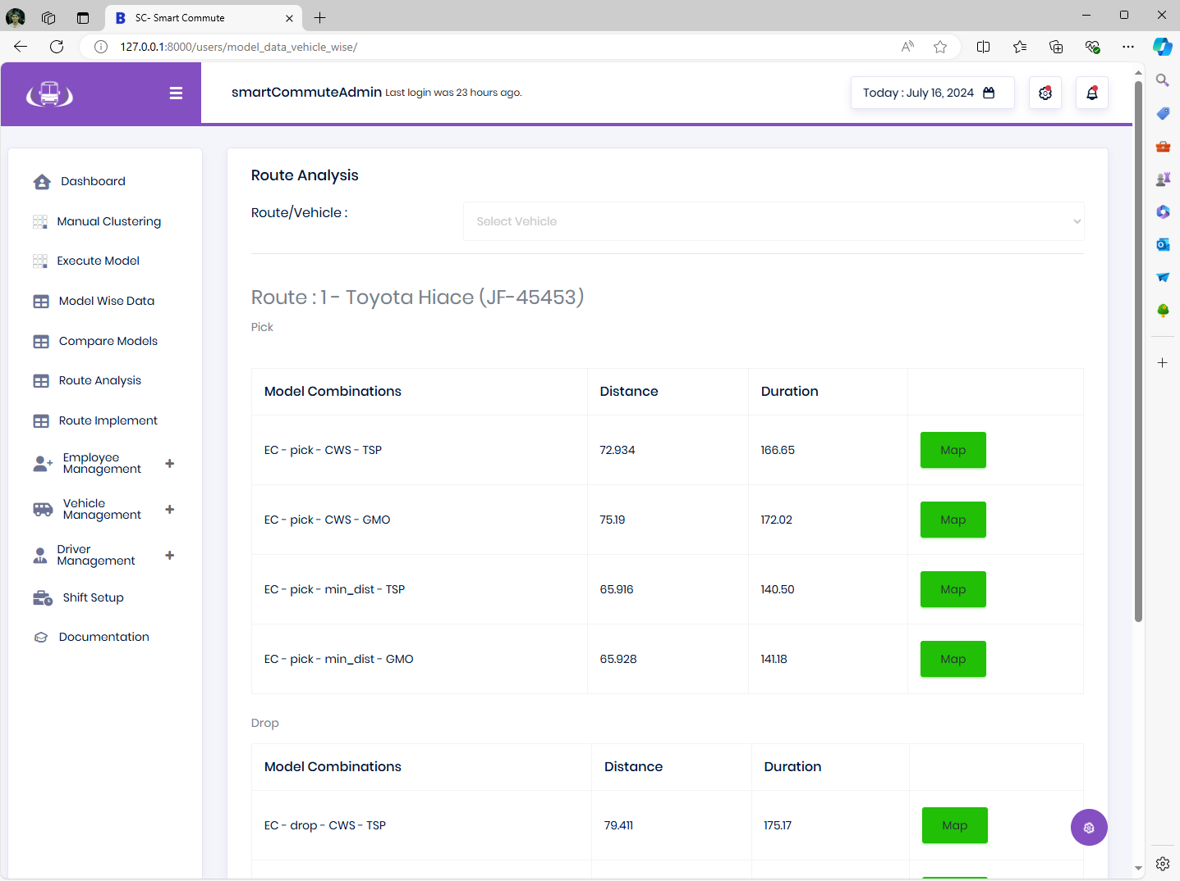
Saved Routes Details

Slide 50
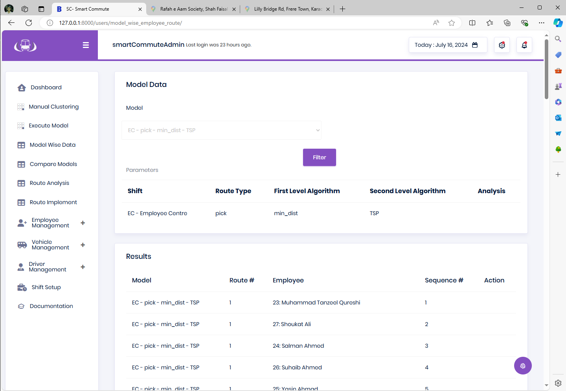
Saved Routings Display

Slide 51
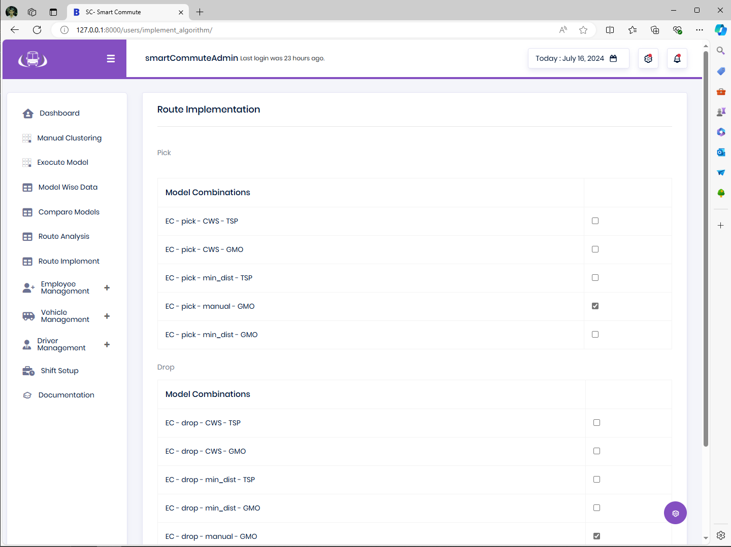
Choice of Route Implementation for display to all Employees

Slide 52
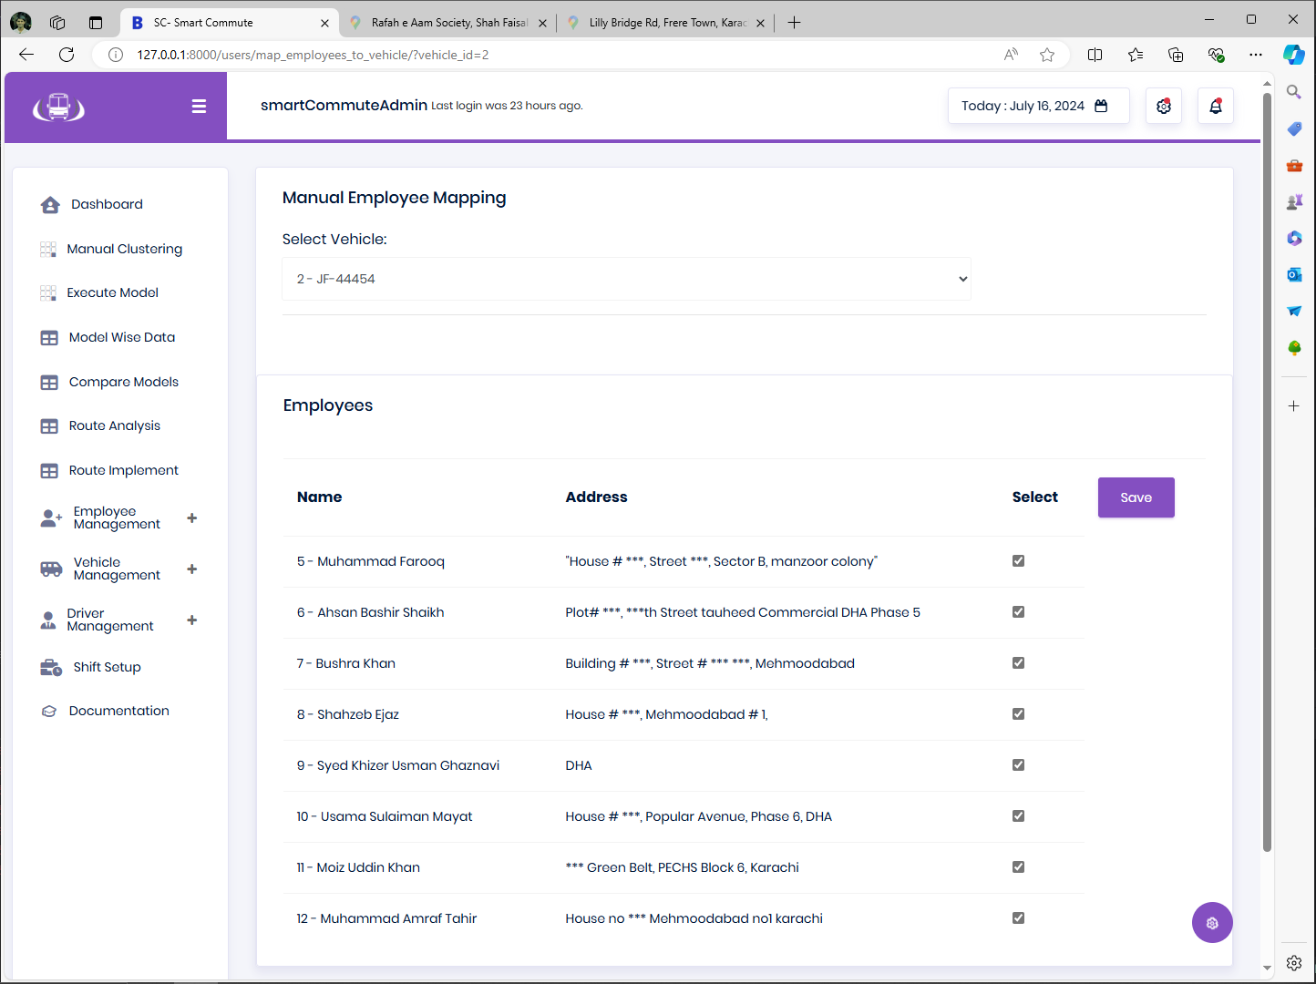
Manual Routing for each employee

Slide 53
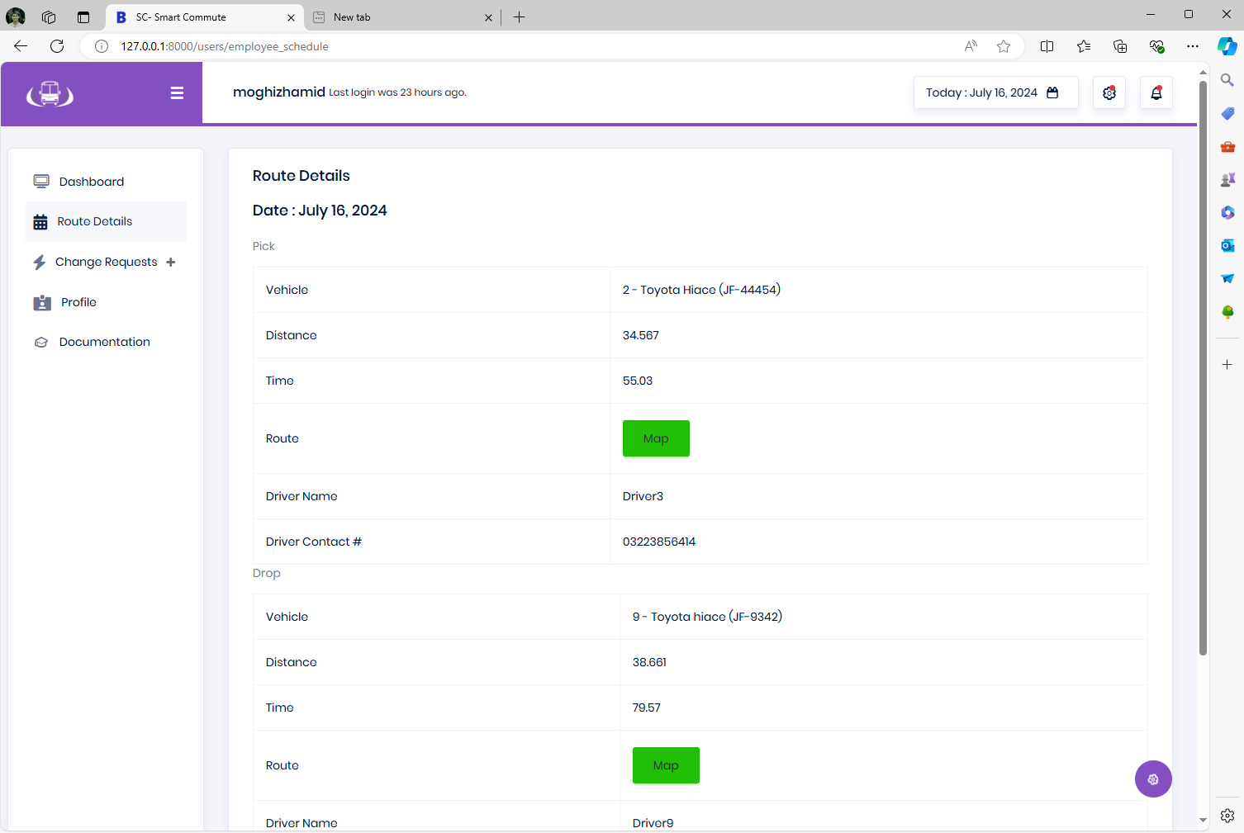
Employee view for respective route detail

Slide 54
Key Benefits
Highly Scalable
Flexible and Diverse
Scalable to accommodate as many employees as required in each shift
The option to choose from multiple routing algorithms as well as different plans for Pickups & Drop offs
Instant Route Generation
Just configure the shift timings and generate new routes Instantly
Measurable
Transparent
High visibility of travel times and durations for informed Cost Structures
Once the route plan is finalized by administrator, It is instantly visible to all stakeholders

Slide 55


Conclusion
As the results reveal that min_distance algorithm with TSP saves upto 43Kms of total travelled distance along with maximizing per vehicle utilization by saving one excess route. This small shift of 80 employees would save PKR 2 million per annum approx. This project has provided the stakeholders with necessary tools to leverage the power of data and APIs to enable smart decision making and robust management of routes through SMARTCOMMUTE.

Slide 56




Thank you
Muhammad Babar Zaib

